Slide 1
Network Compression
Hung-yi Lee 李宏毅
Notes:
Edge computing

Slide 2
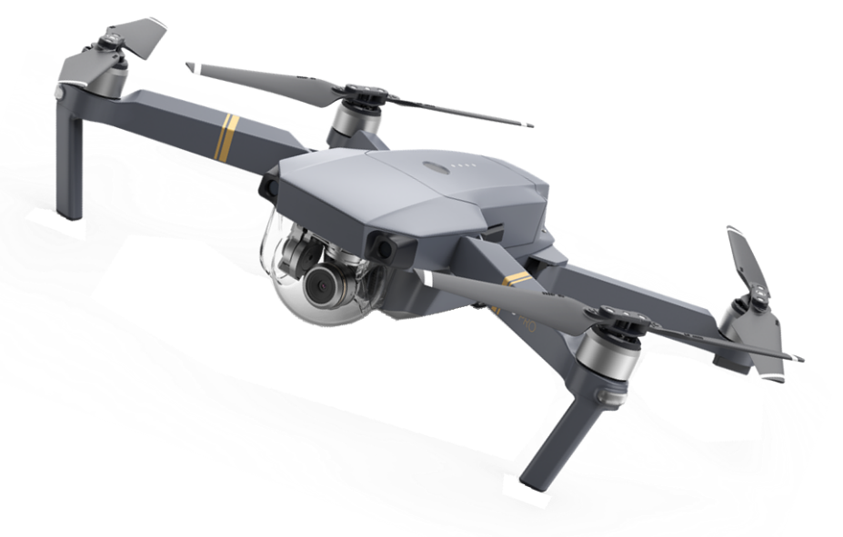


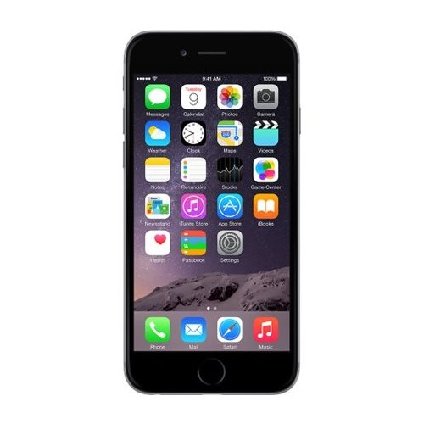
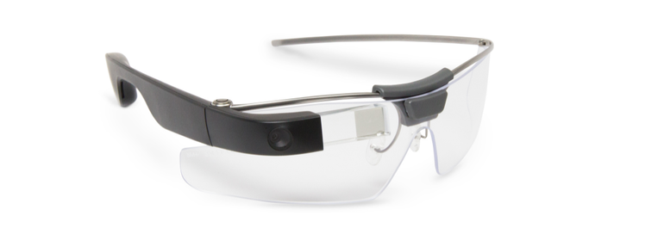
Resource-limited Devices
Limited memory space, limited computing power, etc.
Notes:
memory spaces, limited computing power

Slide 3
Outline
Network Pruning
Knowledge Distillation
Parameter Quantization
Architecture Design
Dynamic Computation
We will not talk about hard-ware solution today.

Slide 4
Network Pruning
Notes:
How to prune?????
Predicting Parameters in Deep Learning

Slide 5
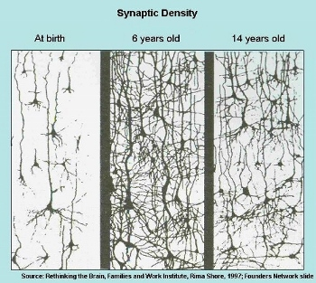
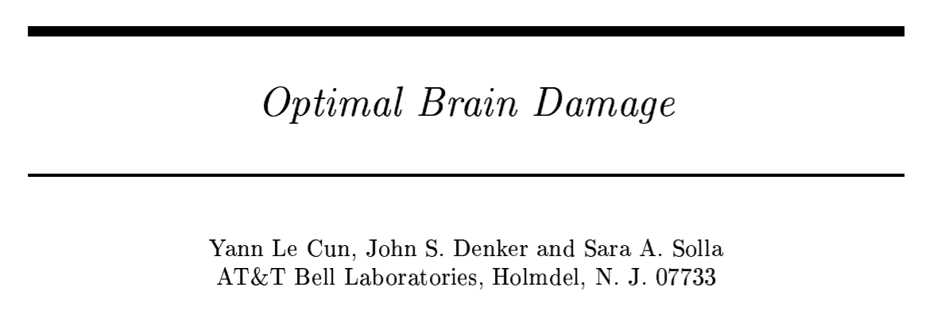
Network can be pruned
Networks are typically over-parameterized (there is significant redundant weights or neurons)
Prune them!

Slide 6
Network Pruning
Pre-trained
Network
large
Importance of a weight:
Evaluate the Importance
L1, L2 ……
Importance of a neuron:
Remove
the number of times it wasn’t zero on a given data set ……
smaller
After pruning, the accuracy will drop (hopefully not too much)
Fine-tune
Fine-tuning on training data for recover
no
Are you happy?
Don’t prune too much at once, or the network won’t recover.
yes
Smaller Network
Notes:
Pruning neural networks is an old idea going back to 1990 (with Yan Lecun’s optimal brain damage work) and before. The idea is that among the many parameters in the network, some are redundant and don’t contribute a lot to the output.
If you could rank the neurons in the network according to how much they contribute, you could then remove the low ranking neurons from the network, resulting in a smaller and faster network.
Getting faster/smaller networks is important for running these deep learning networks on mobile devices.
The ranking can be done according to the L1/L2 mean of neuron weights, their mean activations, the number of times a neuron wasn’t zero on some validation set, and other creative methods . After the pruning, the accuracy will drop (hopefully not too much if the ranking clever), and the network is usually trained more to recover.
If we prune too much at once, the network might be damaged so much it won’t be able to recover.
So in practice this is an iterative process - often called ‘Iterative Pruning’: Prune / Train / Repeat.

Slide 7

Why Pruning?
How about simply train a smaller network?
It is widely known that smaller network is more difficult to learn successfully.
Larger network is easier to optimize? https://www.youtube.com/watch?v=_VuWvQUMQVk
Lottery Ticket Hypothesis
https://arxiv.org/abs/1803.03635
Notes:
The Lottery Ticket Hypothesis: Finding Small, Trainable Neural Networks???

Slide 8

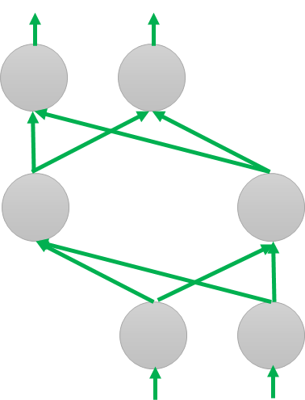
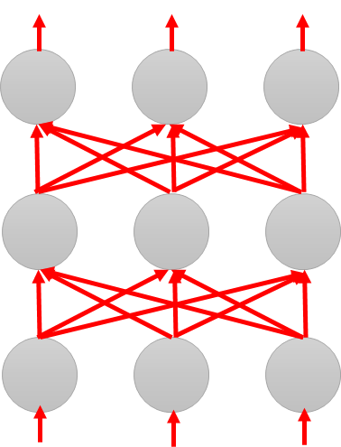
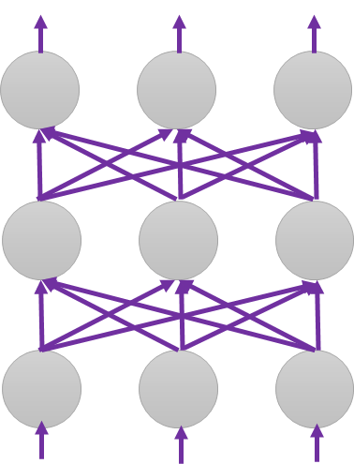
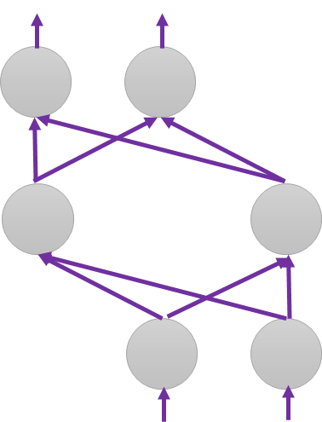
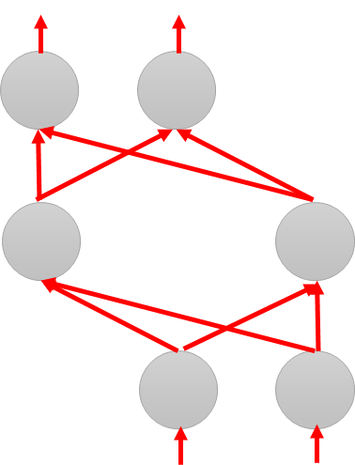

Why Pruning?
Lottery Ticket Hypothesis
Random init
Again
Original
Random init
Random init
Trained
Pruned
Random Init weights
Trained weight
Another random Init weights
Notes:
https://www.plurk.com/p/n27r0g

Slide 9
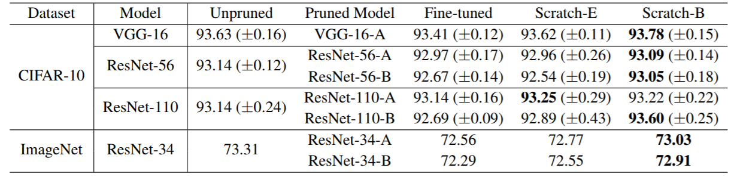
Why Pruning?
Rethinking the Value of Network Pruning
https://arxiv.org/abs/1810.05270
Real random initialization, not original random initialization in “Lottery Ticket Hypothesis”
Pruning algorithms could be seen as performing network architecture search

Slide 10
Network Pruning - Practical Issue
Weight pruning
The network architecture becomes irregular.
Prune some weights
Hard to implement, hard to speedup ……
Notes:
Hard to implement ... Can you implement by keras
Even you can implement
It is hard to speedup by GPU
Actually, use zero to replace -> just 自ｈｉ in paper
We will evaluate model size …..

Slide 11
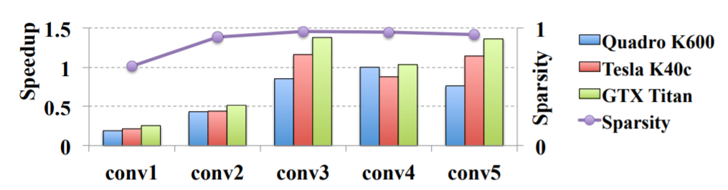
Network Pruning - Practical Issue
Weight pruning
https://arxiv.org/pdf/1608.03665.pdf
Notes:
nVIDIA Quadro K600 12GB 3D 繪圖卡
原廠三年保NVIDIA TESLA K40 12GB GPU K40 / K 40 CUDA 平行運算 ...

Slide 12
Network Pruning - Practical Issue
Neuron pruning
The network architecture is regular.
Prune some neurons
Easy to implement, easy to speedup ……
Notes:
Hard to implement ... Can you implement by keras
Even you can implement
It is hard to speedup by GPU
Actually, use zero to replace -> just 自ｈｉ in paper
We will evaluate model size …..

Slide 13
Knowledge Distillation
Notes:
https://github.com/dkozlov/awesome-knowledge-distillation

Slide 14

Knowledge Distillation
Knowledge Distillation
https://arxiv.org/pdf/1503.02531.pdf
Do Deep Nets Really Need to be Deep?
https://arxiv.org/pdf/1312.6184.pdf
Cross-entropy minimization
Learning target
“1”: 0.7, “7”: 0.2. “9”: 0.1
?
Teacher Net
(Large)
Student Net
(Small)
Providing the information that “1” is similar to “7”

Slide 15
Knowledge Distillation
Knowledge Distillation
https://arxiv.org/pdf/1503.02531.pdf
Do Deep Nets Really Need to be Deep?
https://arxiv.org/pdf/1312.6184.pdf
Cross-entropy minimization
Learning target
“1”: 0.7, “7”: 0.2. “9”: 0.1
?
Average of a set of models
Model 1
Model 2
Student Net
(Small)
N Networks
Ensemble

Slide 16















Knowledge Distillation
Temperature
$$y_{i}=\frac{exp\left(x_{i}\right)}{\sum_{j}{exp\left(x_{j}\right)}}$$
$$y_{i}=\frac{exp\left(x_{i}/T\right)}{\sum_{j}{exp\left(x_{j}/T\right)}}$$
$$T=100$$
$$x_{1}=100$$
$$y_{1}=1$$
$$x_{1}/T=1$$
$$y_{1}=0.56$$
$$x_{2}=10$$
$$y_{2}≈0$$
$$x_{2}/T=0.1$$
$$y_{2}=0.23$$
$$x_{3}=1$$
$$y_{3}≈0$$
$$x_{3}/T=0.01$$
$$y_{3}=0.21$$
Notes:
At least mentioned temperature …

Slide 17
Parameter Quantization
Notes:
BinaryConnect: Training Deep Neural Networks with binary weights during propagations
Binarized neural networks: Training deep neural networks with weights and activations constrained to+ 1 or-1
Xnor-net: Imagenet classification using binary convolutional neural networks
Binary network:
All for quantizaion: https://www.ntnu.edu/documents/139931/1275097249/eecs-jun17-finn.pdf/38a98880-d663-4114-a045-97c80d79ce19
BinaryConnect: Training Deep Neural Networks with binary weights during propagations
Slide: http://web.eng.tau.ac.il/deep_learn/wp-content/uploads/2017/03/Binary-Deep-Learning.pdf
Binarized neural networks
Binarized neural networks: Training deep neural networks with weights and activations constrained to+ 1 or-1
Xnor-net: Imagenet classification using binary convolutional neural networks
Slides: http://www.cs.virginia.edu/~vicente/recognition/2016/presentations/xnornet.pdf
All for quantizaion: https://www.ntnu.edu/documents/139931/1275097249/eecs-jun17-finn.pdf/38a98880-d663-4114-a045-97c80d79ce19
http://www.cs.virginia.edu/~vicente/recognition/2016/presentations/xnornet.pdf

Slide 18
Parameter Quantization
1. Using less bits to represent a value
2. Weight clustering
0.5 | 1.3 | 4.3 | -0.1
0.1 | -0.2 | -1.2 | 0.3
1.0 | 3.0 | -0.4 | 0.1
-0.5 | -0.1 | -3.4 | -5.0
weights in a network
Clustering

Slide 19
Parameter Quantization
1. Using less bits to represent a value
2. Weight clustering
3. Represent frequent clusters by less bits, represent rare clusters by more bits
e.g. Huffman encoding
Table
0.5 | 1.3 | 4.3 | -0.1
0.1 | -0.2 | -1.2 | 0.3
1.0 | 3.0 | -0.4 | 0.1
-0.5 | -0.1 | -3.4 | -5.0
 | -0.4
 | 0.4
 | 2.9
 | -4.2
weights in a network
Clustering
Only needs 2 bits
Notes:
極致就是 binary

Slide 20
Binary Weights
Binary Connect: https://arxiv.org/abs/1511.00363
Binary Network:
https://arxiv.org/abs/1602.02830
XNOR-net:
https://arxiv.org/abs/1603.05279
Your weights are always +1 or -1
Binary Connect
network with binary weights
Negative gradient
network with real value weights
(compute on binary weights)
Update direction
(compute on real weights)
Notes:
Binary Connect

Slide 21
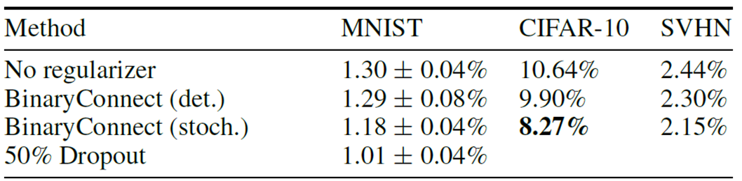
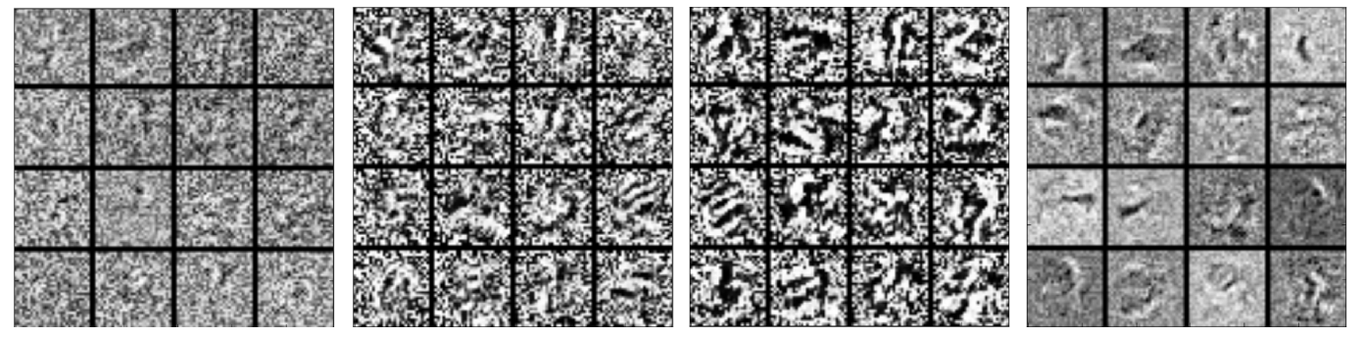
Binary Connect
https://arxiv.org/abs/1511.00363
Notes:
Lower: first layer of MLP on MNIST

Slide 22
Architecture Design
Notes:
Deep Compression: Compressing Deep Neural Networks with Pruning, Trained Quantization and Huffman coding
Easy to read!
https://www.youtube.com/watch?v=vouEMwDNopQ
https://www.youtube.com/watch?v=CrDRr2fxbsg
https://www.zybuluo.com/w460461339/note/1257046

Slide 23
Low rank approximation
M
M
U
W
linear
K
V
N
N
N
K
N
W
U
V
K
M
≈
M
K < M,N
Less parameters

Slide 24
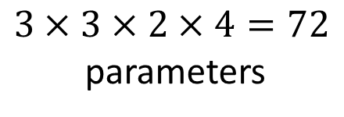
Review: Standard CNN
$$3×3×2×4=72$$
parameters
Input feature map
2 channels

Slide 25

Depthwise Separable Convolution
1. Depthwise Convolution
Filter number = Input channel number
Each filter only considers one channel.
The filters are $k×k$ matrices
There is no interaction between channels.

Slide 26

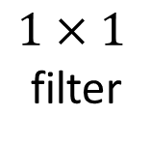

Depthwise Separable Convolution
1. Depthwise Convolution
$$3×3×2=18$$
2. Pointwise Convolution
$1×1$
filter
$$2×4=8$$

Slide 27
18 inputs
18 inputs
9 inputs
9 inputs

Slide 28






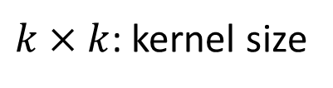

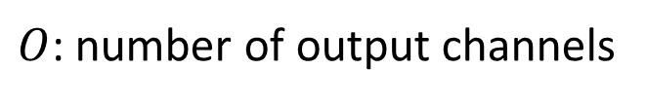


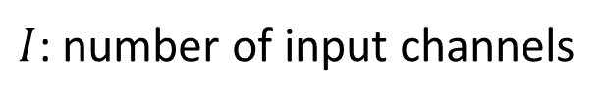


$I$: number of input channels
$$k×k×I$$
$O$: number of output channels
$$k×k×I$$
$k×k$: kernel size
$$k×k×I$$
$$k×k×I+I×O$$
$$k×k×I$$
$$k×k×I×O$$
$$I×O$$
$$=\frac{1}{O}+\frac{1}{k×k}$$
$$k×k×I$$
$$k×k×I+I×O$$
$$(k×k×I)×O$$

Slide 29
To learn more ……
SqueezeNet
https://arxiv.org/abs/1602.07360
MobileNet
https://arxiv.org/abs/1704.04861
ShuffleNet
https://arxiv.org/abs/1707.01083
Xception
https://arxiv.org/abs/1610.02357

Slide 30
Dynamic Computation
Notes:
Adaptive Neural Networks for Efficient Inference
Tolga Bolukbasi, Joseph Wang, Ofer Dekel, Venkatesh Saligrama, “Adaptive Neural Networks for Efficient Inference”arXiv:1702.07811
https://vimeo.com/238242188
Different layers? ???
Multi-scale dense network: http://blog.csdn.net/u014380165/article/details/78006893
https://www.jqr.com/article/000196
在中間就輸出

Slide 31
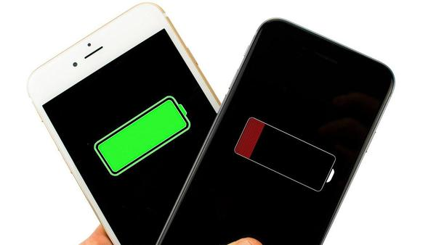

Dynamic Computation
Can network adjust the computation power it need?
資源充足，那麼就做到最好
減少運算量，先求有再求好 (但也不要太差)

Slide 32
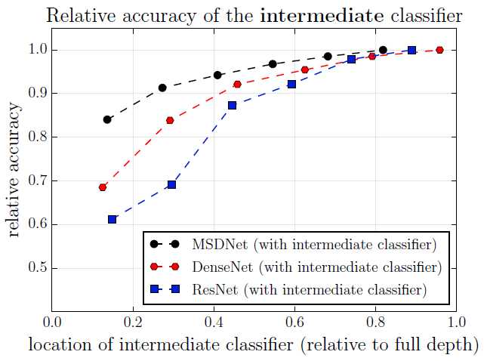
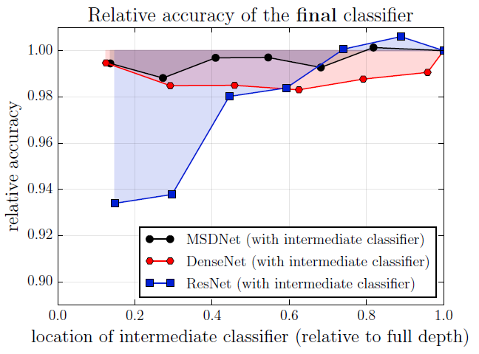
Possible Solutions
Layer
1
Layer
2
input
Classifier
Classifier
1. Train multiple classifiers
2. Classifiers at the intermedia layer
result
result
https://arxiv.org/abs/1703.09844

Slide 33
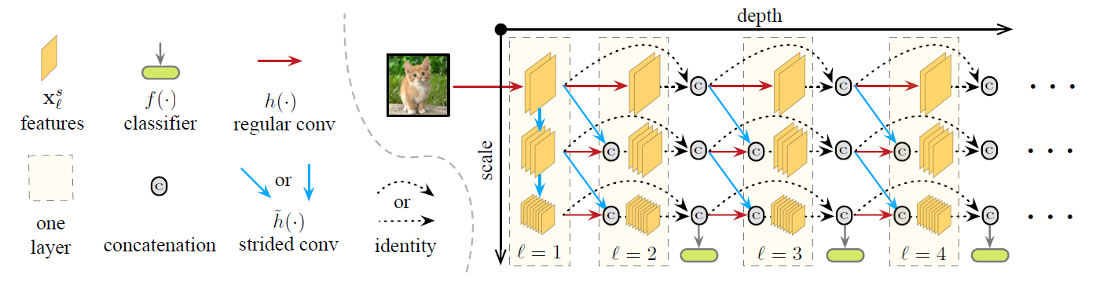
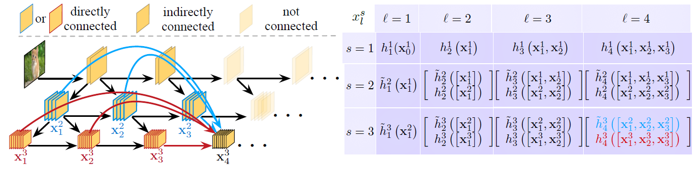
Multi-Scale Dense Networks
https://arxiv.org/abs/1703.09844

Slide 34
Concluding Remarks
Network Pruning
Knowledge Distillation
Parameter Quantization
Architecture Design
Dynamic Computation

